Slide 1
Groceries App
Giancarlo Barillas
Final Project

Slide 2
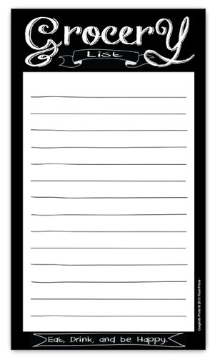
Introduction
Supermarket design
Purchases
Groceries List
Written Grocery List vs Online

Slide 3
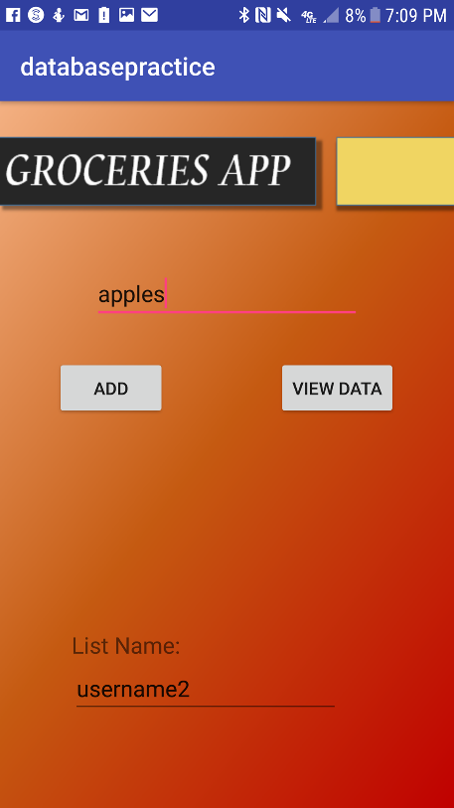
Project Description
Allows users to create an account so that they have their own personal Grocery List.
The list can be modified to contain as many elements
No two users can see the list of the other unless they are grouped or know the login information
Items can be updated and deleted whenever the user wants

Slide 4
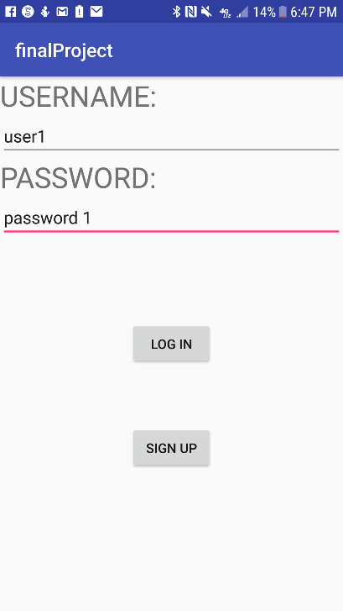
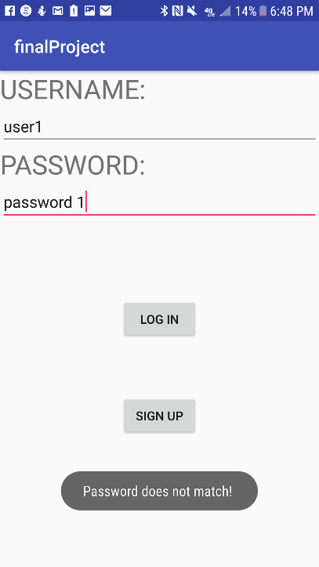
Creating an Account
Error checking to see if the account exist.
Give the user the option create a new account that will lead him to the sign up activity
The user is prompted if the account is wrong or misspelled.

Slide 5
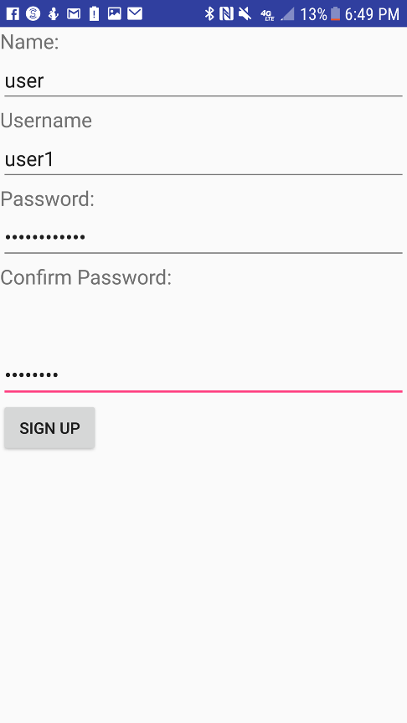
Sign up logic
public void insertContact(contact c){ db=this.getWritableDatabase(); ContentValues values=new ContentValues(); values.put(COLUMN_NAME,c.getName()); values.put(COLUMN_USERNAME,c.getUsername()); values.put(COLUMN_PASSWORD,c.getPassword()); db.insert(TABLE_NAME,null,values); }
Takes in object argument
Put the values into the database
These is a logic to check if the two passwords are the same by using the .equals method.

Slide 6
Log in logic
public String searchPass(String str){ db=this.getReadableDatabase(); String query="SELECT name,pass FROM "+TABLE_NAME; Cursor cursor=db.rawQuery(query,null); String username,password; password="not found"; if(cursor.moveToFirst()) { do{ username=cursor.getString(0); password=cursor.getString(1); if(username.equals(str)) { password=cursor.getString(1); break; } } while (cursor.moveToNext()); } return password; }
Takes in String argument for User
Query name and password from database
Go through the curser to find out what the password is for the given user
Returns the real password to check if they are the same with the user input password.

Slide 7
Grocery List App
After successfully login in to your account you are lead to this activity
This allows you to input an item into your list
viewing the item based on the List Name which is your username
The username is passed to the app so that it can be used later.

Slide 8
List by username Logic
private void populateListView() { Log.d(TAG,"populateListView: Display data in the ListView"); String user=getIntent().getStringExtra("username"); Cursor data=mDatabaseHelper.getDatas(user); ArrayList<String> listData=new ArrayList<>(); while(data.moveToNext()){ listData.add(data.getString(1)); } ListAdapter adapter= new ArrayAdapter<>(this,android.R.layout.simple_list_item_1,listData); mListView.setAdapter(adapter); mListView.setOnItemClickListener(new AdapterView.OnItemClickListener() { @Override public void onItemClick(AdapterView<?> adapterView, View view, int i, long l) { String name=adapterView.getItemAtPosition(i).toString(); Log.d(TAG,"onItemClick: You clicked on "+name); Cursor data=mDatabaseHelper.getItemID(name); int itemID=-1; while(data.moveToNext()){ itemID=data.getInt(0); } if(itemID>=1){ Log.d(TAG,"onItemClick: The id is : "+itemID); Intent editScreenIntent=new Intent(ListDataActivity.this,EditDataActivity.class); editScreenIntent.putExtra("id",itemID); editScreenIntent.putExtra("name",name); startActivity(editScreenIntent); }else { toastMessage("No ID associated with that name"); } } }); }
public Cursor getDatas(String user){ SQLiteDatabase db=this.getWritableDatabase(); String query="SELECT * FROM "+TABLE_NAME+" WHERE "+COL3+" LIKE '"+user+"'"; Cursor data=db.rawQuery(query,null); return data; }
The function on the left populates the list view by taking in the username passed from the pervious activity.
The cursor that is returned from the getDatas() is stored into an arraylist.
An adapter is used to get the information from the listData arraylist.

Slide 9
Update and delete Items
public void updateName(String newName,int id,String oldName){ SQLiteDatabase db=this.getWritableDatabase(); String query = "UPDATE " + TABLE_NAME + " SET " + COL2 + " = '" + newName + "' WHERE " + COL1 + " = '" + id + "'" + " AND " + COL2 + " = '" + oldName + "'"; Log.d(TAG,"updateName: query: "+query); Log.d(TAG,"updateName: setting name to "+newName); db.execSQL(query); }
These are the methods used to update the Items and delete them from the list
Update the table from a query and then executed the query
Delete from the table where the located item is and delete it from the list.
public void deleteName(int id, String name){ SQLiteDatabase db = this.getWritableDatabase(); String query = "DELETE FROM " + TABLE_NAME + " WHERE " + COL1 + " = '" + id + "'" + " AND " + COL2 + " = '" + name + "'"; Log.d(TAG, "deleteName: query: " + query); Log.d(TAG, "deleteName: Deleting " + name + " from database."); db.execSQL(query); }

Slide 10
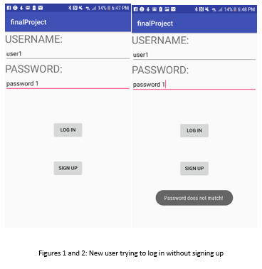
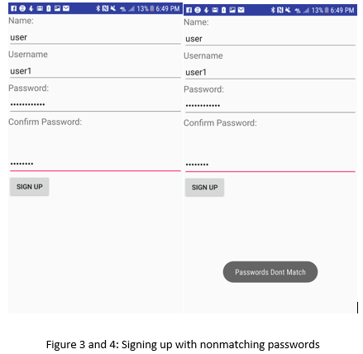
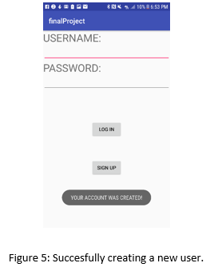
Step by step of the app running

Slide 11
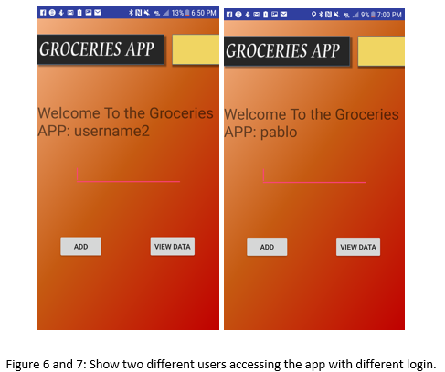
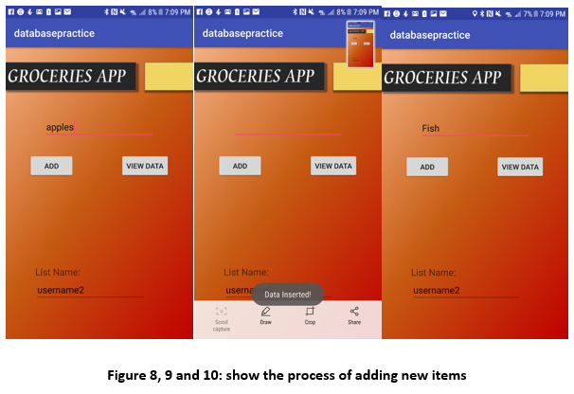
Step by step of the app running

Slide 12
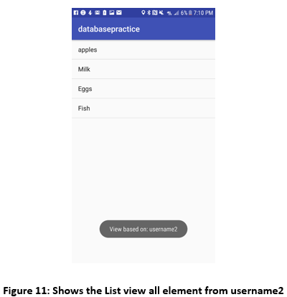
Step by step of the app running

Slide 13
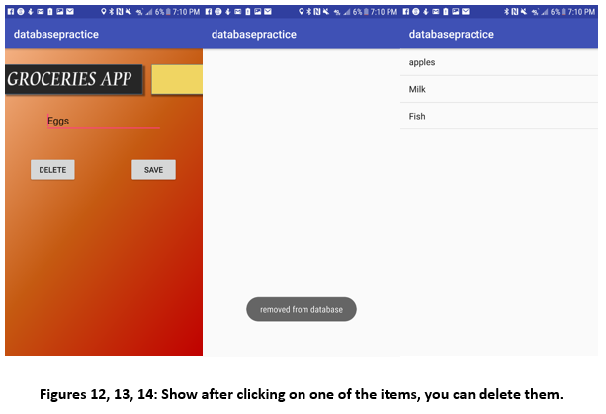
Step by step of the app running

Slide 14
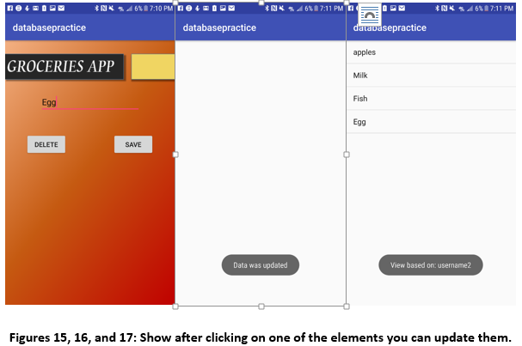
Step by step of the app running

Slide 15
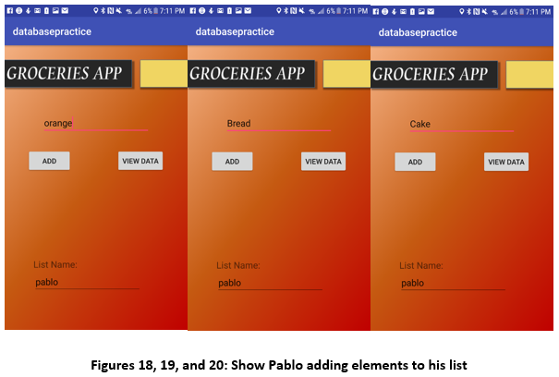
Step by step of the app running

Slide 16
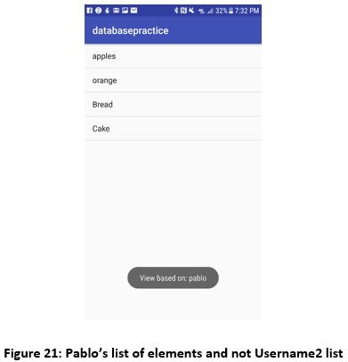
Step by step of the app running

Slide 17
Thank You For Your Time
Question?

